Slide 1

SWE Client Implementations

Slide 2
Example Clients
OXF Rich Client
OXF Web Map Server
Thin SOS Client
Google Maps Display
uDig Plugin

Slide 3
OX - Rich Client
Map- and Diagram-Visualization
Display of associated legends
Management of map layers
Temporal animations
Supported Services: SOS, SAS, SPS, WMS, WCS, CS-W

Slide 4
OX - Rich Client
Demo: Interpolation
Demo: Diagram Animation

Slide 5
OXF Web Map Server
WMS-Frontend encapsulating a SOS
Conforms to WMS 1.1.1
Mapping of sensor data sets to layers
Existing WMS clients can access sensor data
Opaque Service Chaining

Slide 6
Thin SOS Client
Web-based application to access sensor data
Display of time series
Combination of different phenomena
Ajax based
Export: PDF, Excel and CSV
Supports SOS specification 1.0.0 and 0.0.0

Slide 7
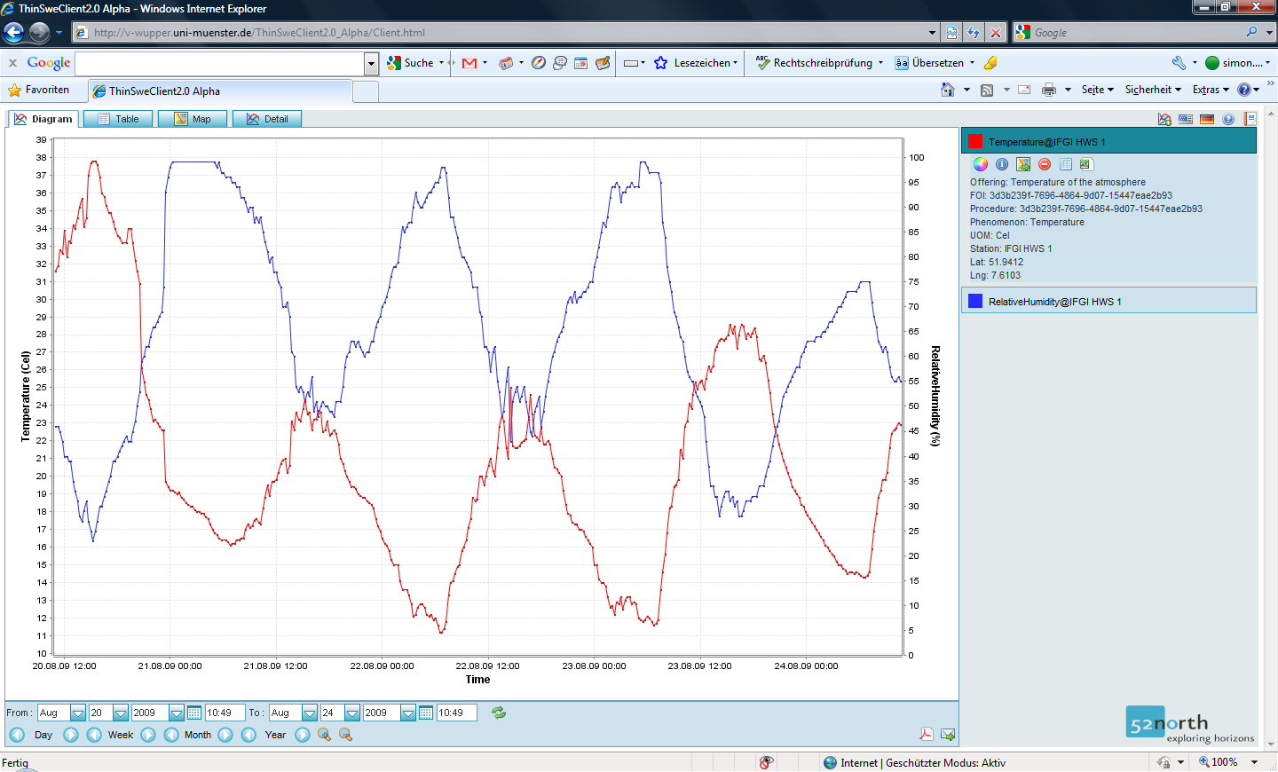
Thin SOS Client

Slide 8
Google Maps Display
Display of sensor positions including the measured phenomena
Link to Thin SOS Client

Slide 9
Google Maps Display
Demo: http://v-swe.uni-muenster.de:8080/WeatherSweClient/index.html

Slide 10
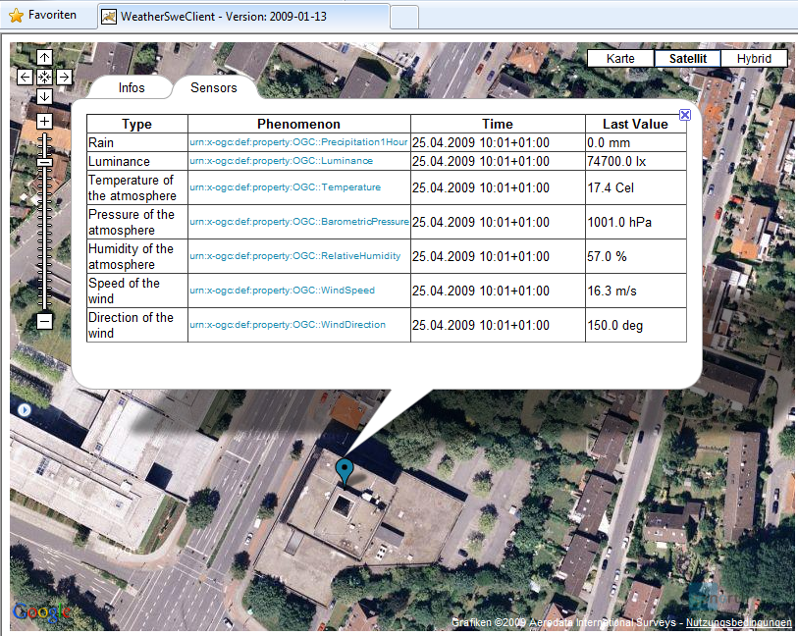

Slide 11
Google Maps Display
Link to demo application:
http://v-swe.uni-muenster.de:8080/WeatherSweClient/

Slide 12
uDig Plugin
uDig
  → Open Source GIS based on Eclipse
Plugin to access a SOS
Integrate features as new layer
View observation data
Current version is compatible to the SOS version 1.0.0

Slide 13
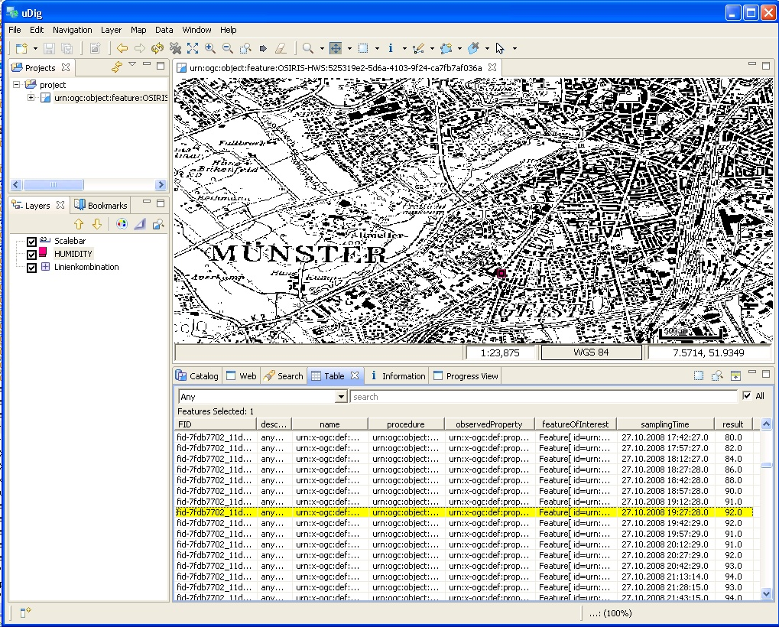
OX - uDig Plugin

Slide 14
Thank you for your attention!

